Slide 2
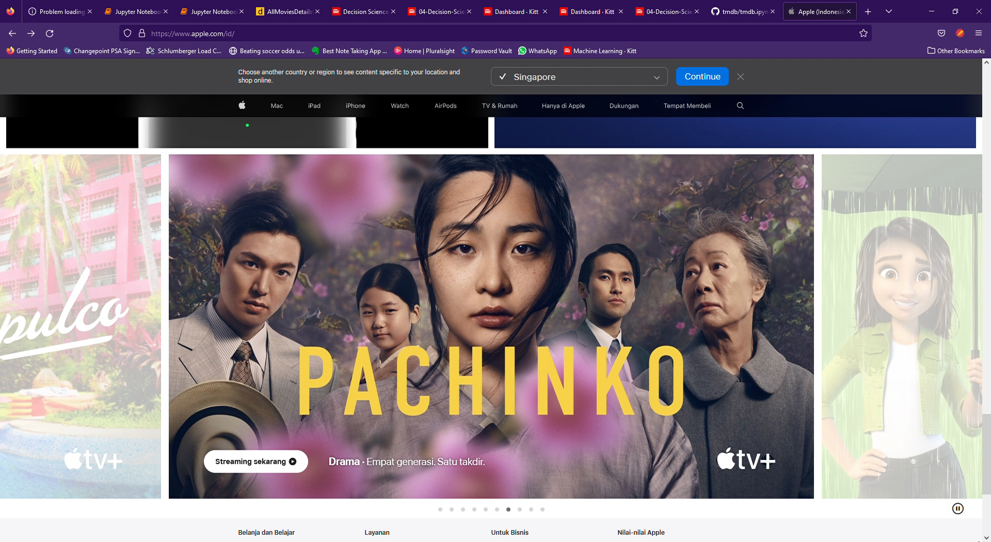
Movie Revenue Prediction
A project by: Team Outliers
Notes:
Hello sir, I have heard about your worry but don’t you worry. We the Outliers got it covered.
You better not waste my time (Sahu)
Allow me just 5 minutes of your time and this will be the best 5 minutes you ever invested as a producer. And let me just by saying that you are not alone…

Slide 3
$60 M
500
50%
Source: motion picture association
Notes:
As you know already, more than 500 movies are released every year in US alone each on an average costing around 60M dollars. And do you know how many of them are successful? 50% (shau). Exactly!

Slide 4
Need
Customer Segment
Product
Our product will cater to director’s and producers to estimate and optimize for the best revenue possible.
Alchemy is a tool for movie makers to estimate the amount of revenue their movie is expected to generate based on their popularity, budget, advertisement etc…
50%
Notes:
However, using our expertise in Data Science we have build a solution that allows Directors and producers, like you, to predict the revenue of the movie. It also helps you take critical decisions by tweaking few characteristics to optimize for the best revenue possible.

Slide 5
Notes:
And to help us achieve this complex and critical tasks, we are using powerful ensemble models such as XGBoost fueled by custom build transformer pipelines that helps you generate prediction with a error margin of 10 Million Dollars. And just to prove how much money you can make with this application; I would like to call upon Ketan to give you a glimpse of our solution “Alchemy”.

Slide 6
Notes:
And now if you’re convinced about the potential of our application, we have a special offer for you. We are giving you a free trial for the first month, and $4999/- for next quarter.
And believe me, John, if you do even half as well as the rest of clients in this fund, you’re going to be very, very impressed. Sound fair enough?

Slide 7
“Business opportunities are like buses. There’s always another one coming.”
Richard Branson
7

